Slide 1
Procedures & Arguments Part 2
Visual Basic

Slide 2
Table OF contents
Lecture context
Functions
Invocation of functions
How does a function works ?
creating Functions
Function Operation Flow Illustration
Passing Arrays to Functions
Passing Arrays to Procedures
Passing Arrays to Functions
Passing Arrays to and returning from a function

Slide 3

Lecture context
Most programs are quite large when one considers the total number of lines of code.
This size links to complexity and as complexity grows, the error count grows exponentially along with the debugging time.
. The accepted method of dealing with this is to break the program down into small sections.
Procedures accomplish this and Functions are the second type we will look at.
Functions allow one to pass data in and return a value and thus are often more useful than subroutines.

Slide 4
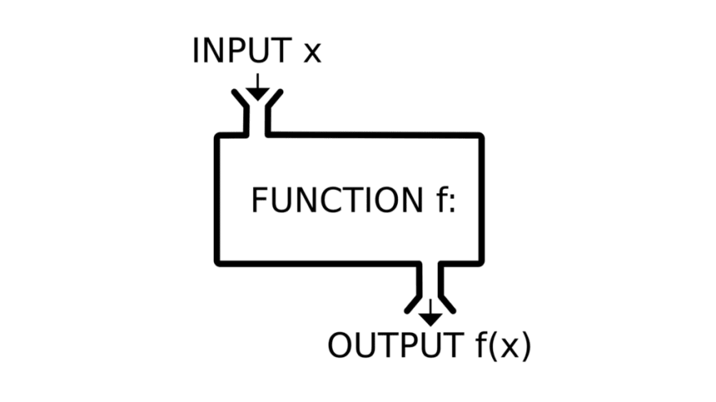
Functions
Code is broken into smaller sections for easier program design, easier debugging and more flexible programming
They are similar to subroutines but can return arguments as well as receiving them as inputs
Function names have data types associated with them (subs do not)
Declaration: Private Function name(inputs)as Type

Slide 5
Functions
As with SubRoutines, we may pass arguments in By Value or By Reference
This (useless) example shows the typical format or ‘shape’ of a Function
Data is returned to the calling procedure using the Return command
Private Function Reduce(ByVal intVal1 as Integer) as integer
Dim intResult as Integer
intResult = intVal1 - 5
Return(intResult) ‘return what is in the brackets to calling procedure
End Function

Slide 6
Invocation of functions
Invocation different to subs as function returns something that we must store in a variable for further processing
After run, intReturnedResult will contain 23-5, the same value as returned by Reduce Function
Functions can return only a single item (may be
an array or structure)
Data passed into function is ‘local’: variables created as procedure is run – efficient resource use!
intReturnedResult = Reduce(23)

Slide 7
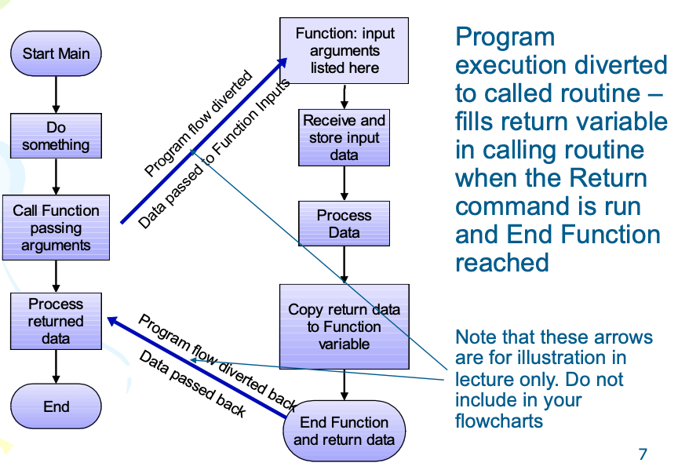
How does a FUNCTION work ?

Slide 8
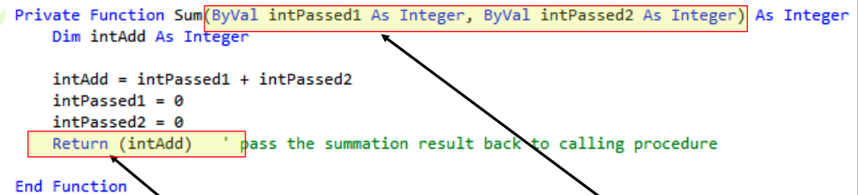
Creating Functions
This Function receives 2 COPIES of original variables’ contents and RETURNS one value
Input variables are declared in the brackets as in a sub routine and receive data (ByVal) or address (ByRef) from the calling routine.
Return value (back to the calling routine) is defined when the Return instruction is encountered

Slide 9
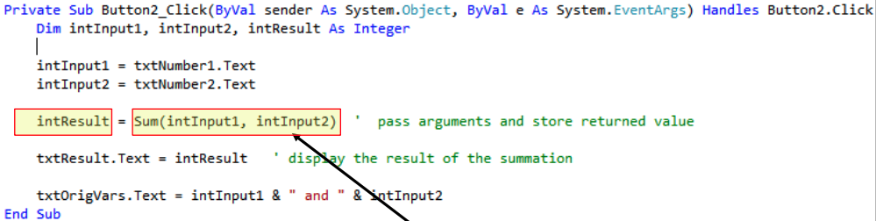
Creating Functions
Passes the intInput1 and intInput2 to the Function after reading from the textboxes
Return value stored in intResult
After the code is run: Sum = 12 and intVal1 = 10, intVal2 = 2 (original variables unchanged when using ByVal in the Function declaration)

Slide 10
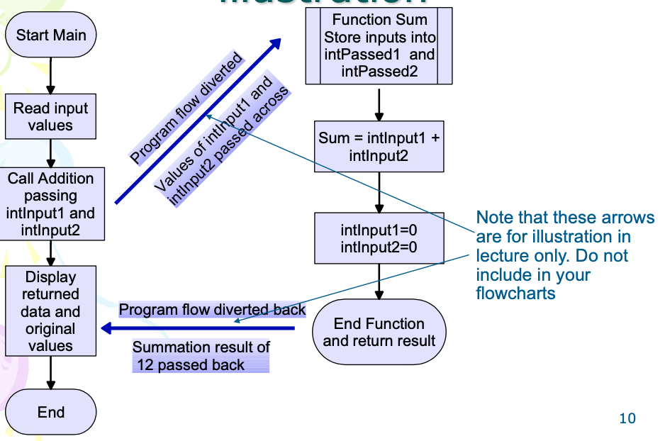
Function operation flow illustration

Slide 11
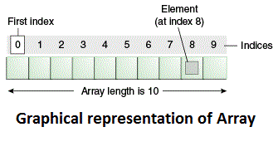
Passing arrays to functions
Most often with engineering applications process groups of data, especially in instrumentation applications
Arrays may be passed into and returned by Functions, but care must be taken with syntax
When passing to a Function, do not use parentheses after the array name
Input arrays must be dynamic
The laboratory coursework requires that you pass arrays into and out of procedures

Slide 12
Passing arrays to functions
The following example program fills an array with the values 1-16 in a For Loop construct
It then passes this array By Value (a copy of the Array’s contents) to the ‘Sum’ Function – note no parentheses after the array name
Program flow passes to the Function and the array’s values are summed in another For Loop
The summation result, stored in intTemp, is returned to the calling procedure and appears in intReturnedSum (NOTE intTemp and IntReturnedSum must be of the same TYPE)

Slide 13
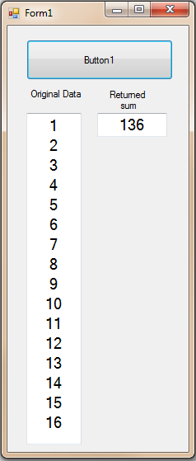
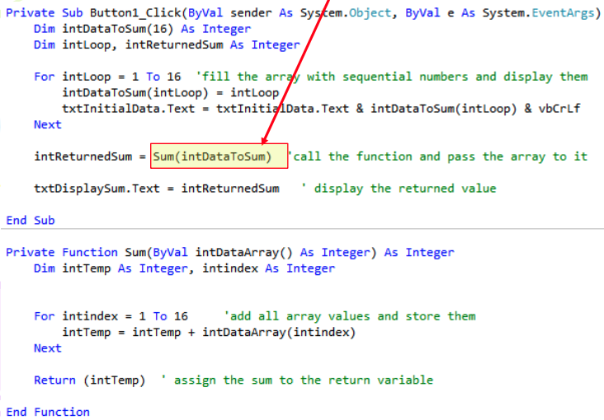
Passing arrays to Procedures
Must pass an array to a procedure with empty parentheses

Slide 14
Passing arrays to Functions
The next example program is identical until the Function call line which has an Array as the receptacle for returned data (no parentheses)
The Function reverses the order of the 16 passed values in a For Loop construct by storing one in a temporary variable, overwriting it with the opposite value, then copying the temporary value to the opposite’s location
Eg. 1 is put into Temp, overwritten in the array by 16, then Temp overwrites 16 in the array
The Function then returns the reversed array

Slide 15
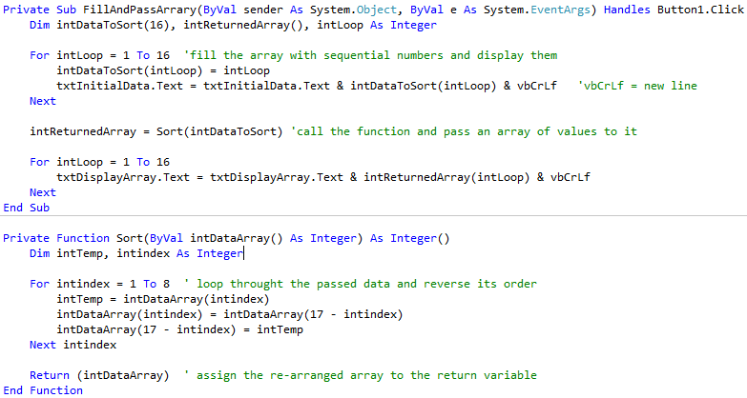
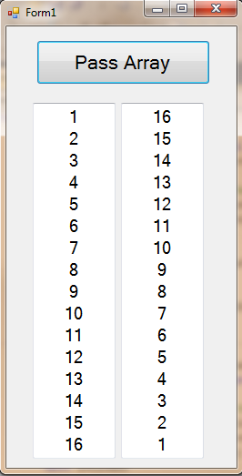
Passing arrays to AND Returning from a function
Pass the array into the Function without parentheses and none on receiving variable either
Return variable has no parentheses

